Slide 1
By – Swetang
By- Swetang Krishna

Slide 2
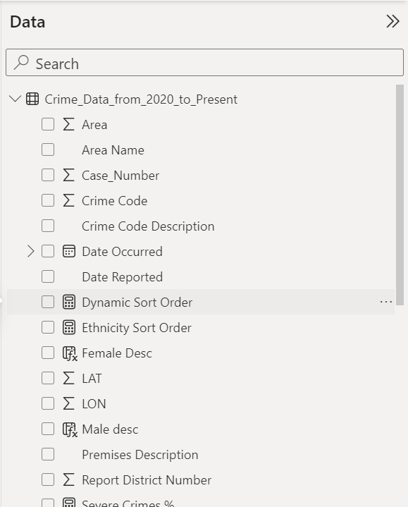
Data Integration and Pre-processing
Collected data
Standardization of raw crime data
Enriching the data
Removing duplicates, handling missing values
Augmenting data (Date format)
Creating new calculated fields, normalizing data
Final Dataset

Slide 3
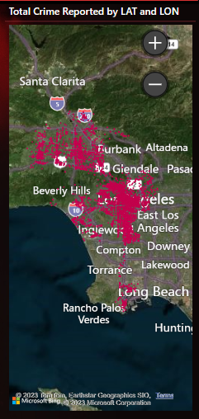
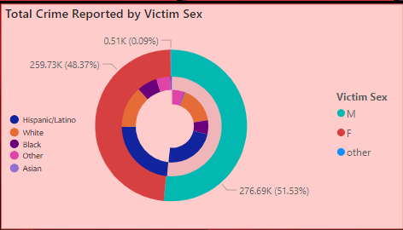
Innovative Visualization Techniques
Cards
Nested DOUGHNUT CHART
Aerial Map
"Temporal trends with bar charts"
"Demographic details with doughnut charts"
"Age distribution with area charts"
"Spatial analysis with geo-map"

Slide 4
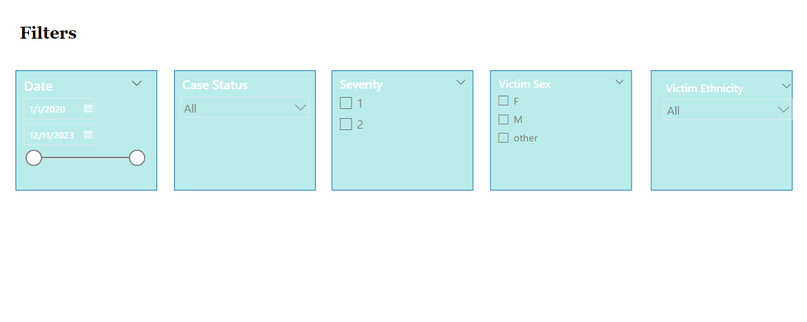
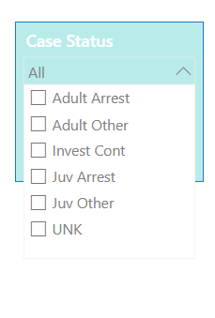
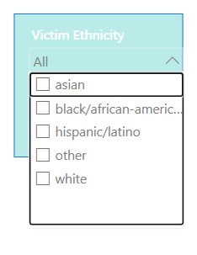
Interactive Dashboard Features
"Dynamic tooltips for detailed data on hover“
"Customizable filters for targeted analysis"

Slide 5
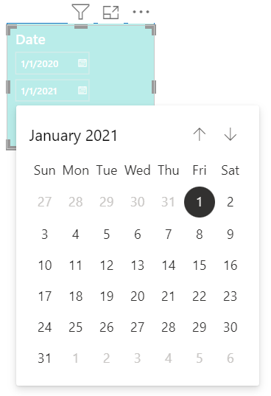
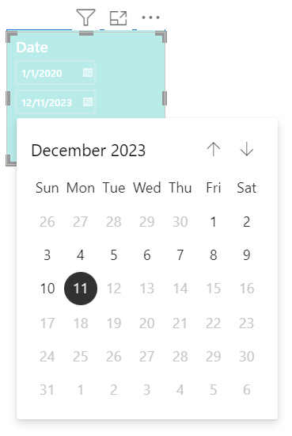
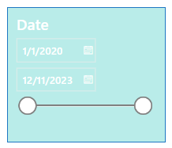
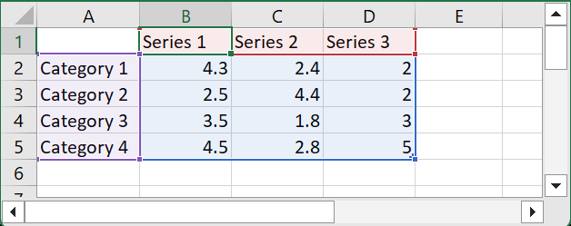
Overcoming Technical Challenges
"Data volume management"
"User-friendly interface design“
"Device scalability"

Slide 6
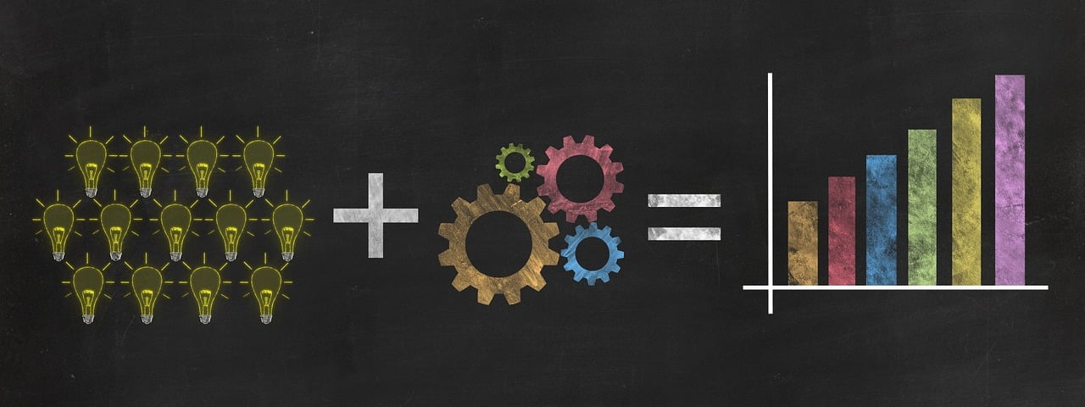
Impact of Technical Advancements
Implications for policy and law enforcement"
Tool for informed decision-making"

Slide 7
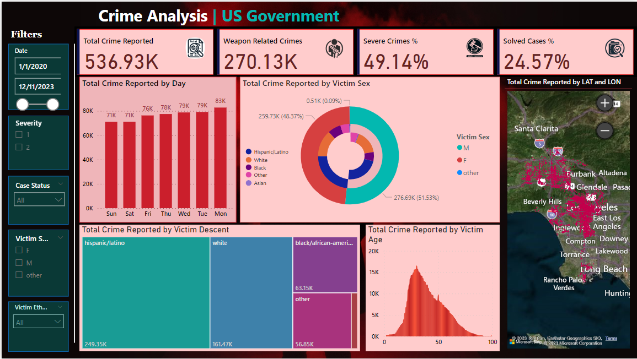
Data Integration and Pre-processing
A LOOK AT THE DASHBOARD

